Slide 1


Content Analysis: Spotlight on the Top 5 Most Popular Categories

Slide 2


Today's agenda
Project recap
Problem
The Analytics team
Process
Insights
Summary

Slide 3

Social Buzz is a small social media company based in San Francisco looking to scale up. It is seeking advisory from an experienced company like Accenture on:
An audit of their big data practice
Recommendations for a successful IPO
An analysis of their content categories that highlights the top 5 categories with the largest popularity
Project Recap

Slide 4


Problem
Over 100 ways to react to content.
100000 pieces of content, ranging from text, images, videos and GIFs
500 million active users each month.
How do we make sense of this amount of data?
By an analysis of their content categories that highlights the top 5 categories with the largest popularity

Slide 5



Andrew Fleming
Chief Technical Architect
The Analytics team
Marcus Rompton
Senior Principle
Eunice Odolokor
Data Analyst

Slide 6
Define the Objective
Process
1
2
Understanding the Data
3
Data Cleaning
4
Exploratory Data Analysis
5
Present Visualizations and Insights

Slide 7

Insights
16
Unique Content Categories
1368
Reactions to the most Popular Category
May
is the month with
the Most Amount of Posts

Slide 8
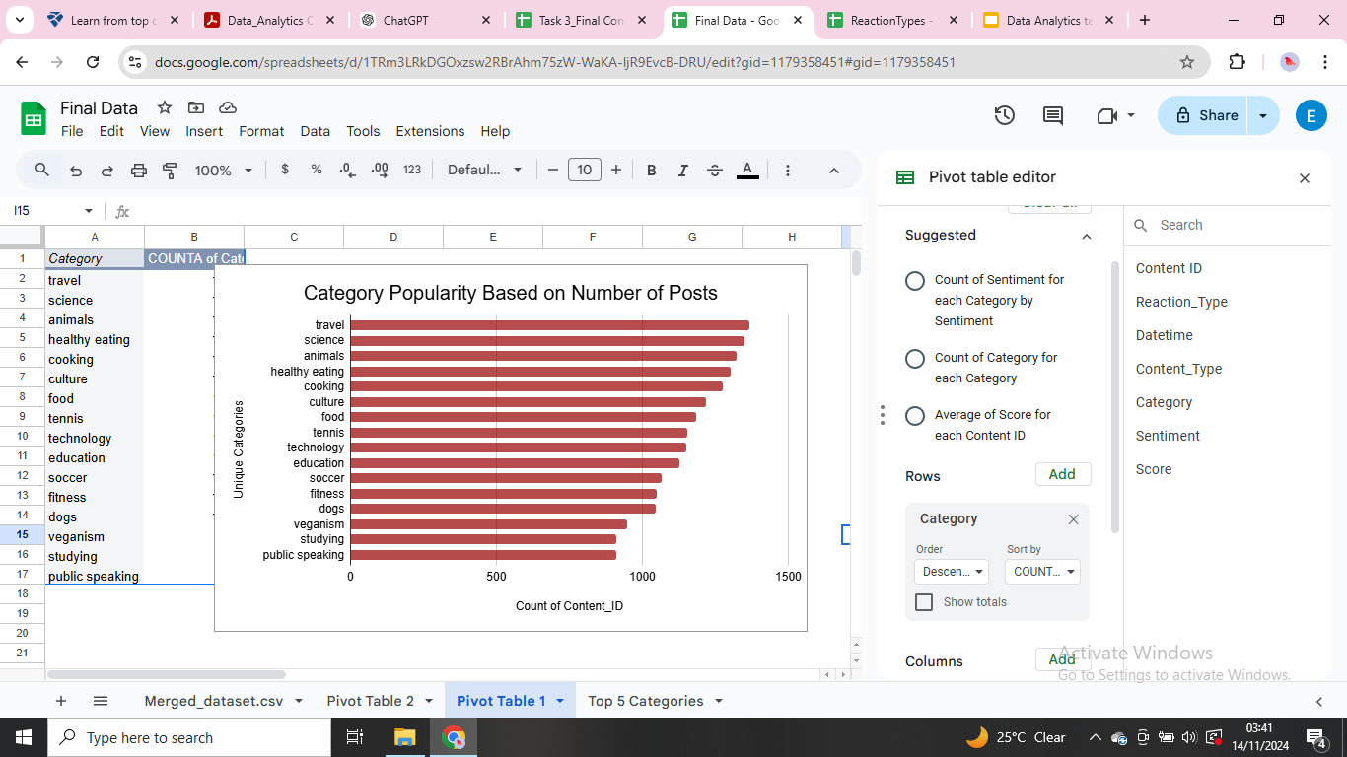

Slide 9
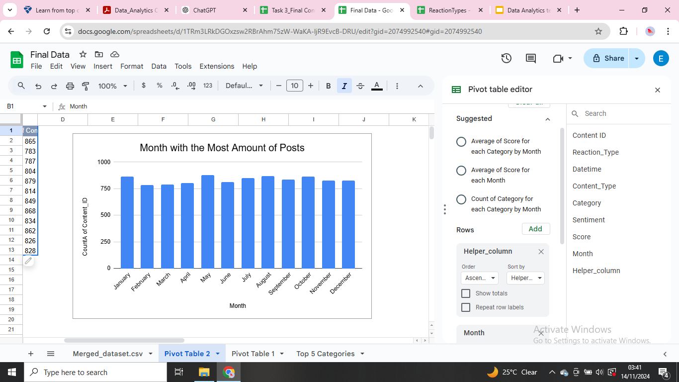
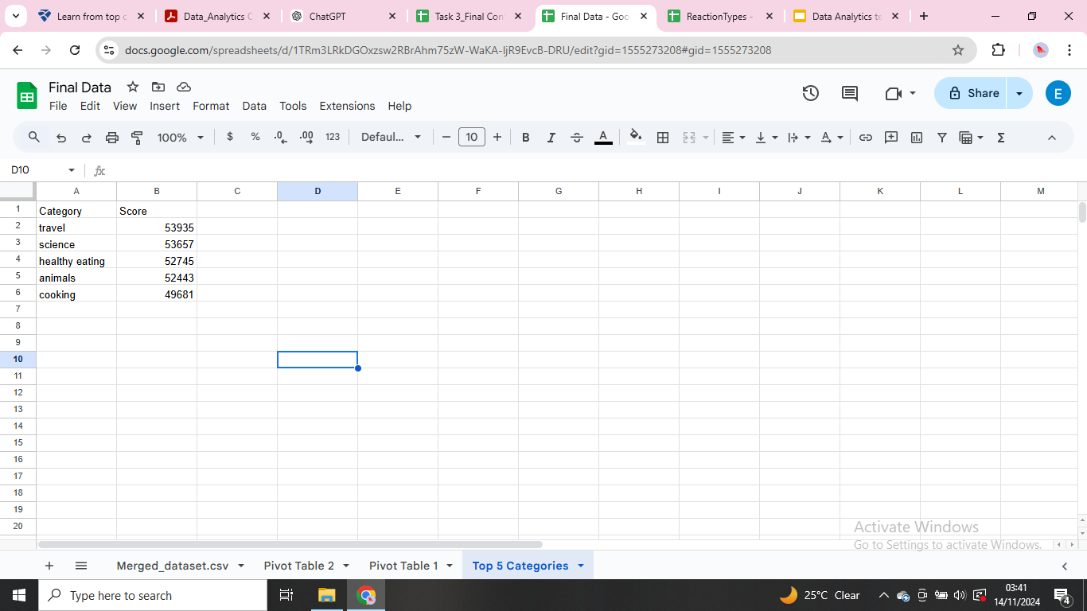
Top 5 Categories

Slide 10

There are 16 unique categories of content
Summary
The five most popular content categories are travel, science,healthy eating, animals and cooking.
Number of posts are highest in the month of May and lowest in the month of February

Slide 11

Thank you!
ANY QUESTIONS?

